Slide 1
Genetic Algorithms
Note: Some slides and/or pictures are adapted from Lecture slides / Books of
Dr Zafar Alvi.
Text Book - Aritificial Intelligence Illuminated by Ben Coppin, Narosa Publishers.
Ref Books
Artificial Intelligence- Structures & Strategies for Complex Problem Solving by George F. Luger, 4th edition, Pearson Education.
Artificial Intelligence A Modern Approach by Stuart Russell & Peter Norvig.
Artificial Intelligence, Third Edition by Patrick Henry Winston

Slide 2
Hill Climbing in Parallel
Suppose we were to climb up a hill.
Our goal is to reach the top irrespective of how we get there.
We apply different operators at a given position, and move in the direction that gives us improvement (more height).
What if instead of starting from one position we start to climb the hill from different positions as indicated by the diagram below.

Slide 3
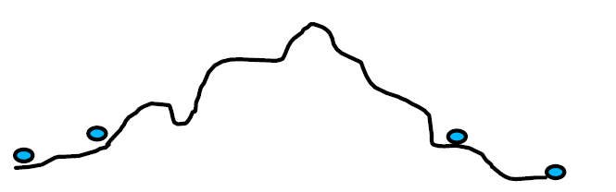
Hill Climbing in Parallel
In other words, we start with different independent search instances that start from different locations to climb up the hill.
Further think that we can improve this using a collaborative approach where these instances interact and evolve by sharing information in order to solve the problem.
However, it is possible to implement parallelism in the sense that the instances can interact and evolve to solve the solution.
Such implementations and algorithms are motivated from the biological concept of evolution of our genes, hence the name Genetic Algorithms, commonly terms as GA.

Slide 4
Basic Terminologies
Individuals (animals or plants) produce a number of offspring (children) which are almost, but not entirely, like themselves.
Variation may be due to mutation (random changes), or due to inheritance (offspring/children inherit some characteristics from each parent).

Slide 5
Genetic Algorithm
Genetic Algorithms is a search method in which multiple search paths are followed in parallel.
At each step, current states of different pairs of these paths are combined to form new paths.
This way the search paths don't remain independent, instead they share information with each other and thus try to improve the overall performance of the complete search space.

Slide 6
Basic Genetic Algorithm
Start with a population of randomly generated, (attempted) solutions to a problem
Repeatedly do the following:
Evaluate each of the attempted solutions
Keep the “best” solutions
Produce next generation from these solutions (using “inheritance” and “mutation”)
Quit when you have a satisfactory solution (or you run out of time)

Slide 7
Problem 1
Suppose your “individuals” are 32-bit computer words
You want a string in which all the bits in these words are ones
Here’s how you can do it:
Create 100 randomly generated computer words
Repeatedly do the following:
Count the 1 bits in each word
Exit if any of the words have all 32 bits set to 1
Keep the ten words that have the most 1s (discard the rest)
From each word, generate 9 new words as follows:
Pick a random bit in the word and toggle (change) it
Note that this procedure does not guarantee that the next “generation” will have more 1 bits, but it’s likely

Slide 8
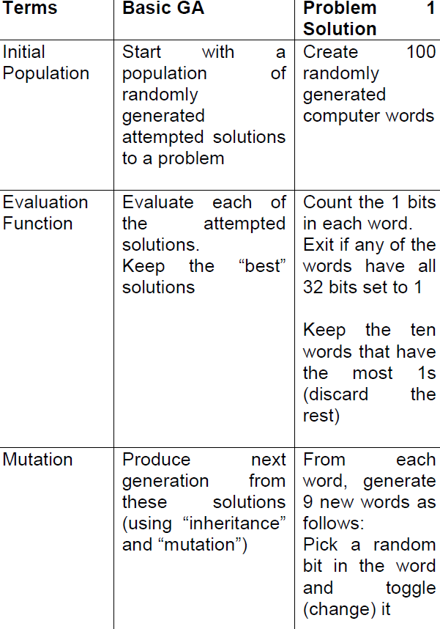

Slide 9
Discussion
Mutation to generate the new individuals.
An evaluation function is the criteria that check various individuals / solutions for being better than others in the population.
Notice that mutation can be as simple as just flipping a bit at random or any number of bits.
We go on repeating the algorithm until we either get our required word that is a 32-bit number with all ones, or we run out of time.
If we run out of time, we either present the best possible solution (the one with most number of 1-bits) as the answer or we can say that the solution can’t be found.
Hence GA is at times used to get optimal solution given some parameters

Slide 10
Problem 2
Suppose you have a large number of data points (x, r), e.g., (1, 5), (3, 9), ...
You would like to fit a polynomial (of up to degree 1) through these data points
That is, you want a formula y = mx + c that gives you a reasonably good fit to the actual data
Here’s the usual way to compute goodness of fit of the polynomial on the data points:
Compute the sum of (actual r – predicted ý)² for all the data points
The lowest sum represents the best fit
You can use a genetic algorithm to find a “pretty good” solution

Slide 11
Solution
Your formula is y = mx + c
Your unknowns are m and c; where m and c are integers
Your representation is the array [m, c]
Your evaluation function for one array is:
For every actual data point (x, r)
Compute ý = mx + c
Find the sum of (r – ý)² over all x
The sum is your measure of “badness” (larger numbers are worse)
Example: For [5, 7] and the data points (1, 10) and (2, 13):
ý = 5x + 7 = 12 when x is 1
ý = 5x + 7 = 17 when x is 2
(10 - 12)² + (13 – 17)² = 2² + 4² = 20
If these are the only two data points, the “badness” of [5, 7] is 20

Slide 12
Solution
Your algorithm might be as follows:
Create two-element arrays of random numbers
Repeat 50 times (or any other number):
For each of the arrays, compute its badness (using all data points)
Keep the best arrays (with low badness)
From the arrays you keep, generate new arrays as follows:
Convert the numbers in the array to binary, toggle one of the bits at random
Quit if the badness of any of the solution is zero
After all 50 trials, pick the best array as your final answer

Slide 13
First Iteration
Consider that the given points are as follows. (x, r) : {(1,5) (3, 9)}
Initial population (m and c) [2 7][1 3]
Compute badness for [2 7]
ý = 2x + 7 = 9 when x is 1
ý = 2x + 7 = 13 when x is 3
(5 – 9)² + (9 – 13)² = 42 + 42 = 32
Compute badness for [1 3]
ý = 1x + 3 = 4 when x is 1
ý = 1x + 3 = 6 when x is 3
(5 – 4)² + (9 – 6)² = 12 + 32 = 10
Lets keep the one with low “badness” [1 3]
Representation [001 011]
Apply mutation to generate new arrays [011 011]
Now we have [1 3] [3 3] as the new population considering that we keep the two best individuals

Slide 14
Second Iteration
(x, r) : {(1,5) (3, 9)}
[1 3][3 3]
ý = 1x + 3 = 4 when x is 1
ý = 1x + 3 = 6 when x is 3
(5 – 4)² + (9 – 6)² = 12 + 32 = 10
ý = 3x + 3 = 6 when x is 1
ý = 3x + 3 = 12 when x is 3
(5 – 6)² + (9 – 12)² = 1 + 9 = 10
Lets keep the [3 3]
Representation [011 011]
Apply mutation to generate new arrays [010 011]
Now we have [3 3] [2 3] as the new population

Slide 15
Third Iteration
(x, r) : {(1,5) (3, 9)}
[3 3][2 3]
ý = 3x + 3 = 6 when x is 1
ý = 3x + 3 = 12 when x is 3
(5 – 6)² + (9 – 12)² = 1 + 9 = 10
ý = 2x + 3 = 5 when x is 1
ý = 2x + 3 = 9 when x is 3
(5 – 5)² + (9 – 9)² = 0² + 0² = 0
Solution found [2 3]
y = 2x+3

Slide 16
Discussion
So you see that how by going though the iteration of a GA one can find a solution to the given problem.
It is not necessary in the above example that you get a solution that gives 0 badness.
In case we go on doing iterations and we run out of time, we might just present the solution that has the least badness as the most optimal solution given these number of iterations on this data.

Slide 17
Discussion
In the examples so far, each “Individual” (or “solution”) had only one parent.
The only way to introduce variation was through mutation (random changes).
In Inheritance or Crossover, each “Individual” (or “solution”) has two parents.
Assuming that each organism has just one chromosome, new offspring are produced by forming a new chromosome from parts of the chromosomes of each parent.
Let us repeat the 32-bit word example again but this time using crossover instead of mutation.

Slide 18
Crossover
Suppose your “organisms” are 32-bit computer words, and you want a string in which all the bits are ones
Here’s how you can do it:
Create 100 randomly generated computer words
Repeatedly do the following:
Count the 1 bits in each word
Exit if any of the words have all 32 bits set to 1
Keep the ten words that have the most 1s (discard the rest)
From each word, generate 9 new words as follows:
Choose one of the other words
Take the first half of this word and combine it with the second half of the other word

Slide 19
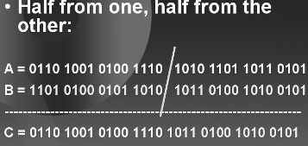
Crossover
Notice that we are generating new individuals from the best ones by using crossover.
The simplest way to perform this crossover is to combine the head of one individual to the tail of the other, as shown in the diagram below.

Slide 20
Crossover
In the 32-bit word problem, the (two-parent, no mutation) approach, if it succeeds, is likely to succeed much faster because up to half of the bits change each time, not just one bit.
However, with no mutation, it may not succeed at all.
By pure bad luck, maybe none of the first (randomly generated) words have (say) bit 17 set to 1.
Then there is no way a 1 could ever occur in this position.
Another problem is lack of genetic diversity.
Maybe some of the first generation did have bit 17 set to 1, but none of them were selected for the second generation.
The best technique in general turns out to be a combination of both, i.e., crossover with mutation.

Slide 21

Eight Queens Problem
The problem is to place 8 queens on a chess board so that none of them can attack the other. A chess board can be considered a plain board with eight columns and eight rows.

Slide 22
Eight Queens Problem
The possible cells that the Queen can move to when placed in a particular square are shown (on White board)
We now have to come up with a representation of an individual/ candidate solution representing the board configuration which can be used as individuals in the GA.

Slide 23
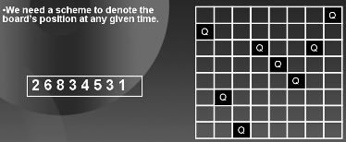

Slide 24
Eight Queens Problem
Where the 8 digits for eight columns specify the index of the row where the queen is placed.
For example, the sequence 2 6 8 3 4 5 3 1 tells us that in first column the queen is placed in the second row, in the second column the queen is in the 6th row so on till in the 8th column the queen is in the 1st row.

Slide 25
Eight Queens Problem
Now we need a fitness function, a function by which we can tell which board position is nearer to our goal.
Since we are going to select best individuals at every step, we need to define a method to rate these board positions or individuals.
One fitness function can be to count the number of pairs of Queens that are not attacking each other.
An example of how to compute the fitness of a board configuration is given in the diagram on the next page.

Slide 26
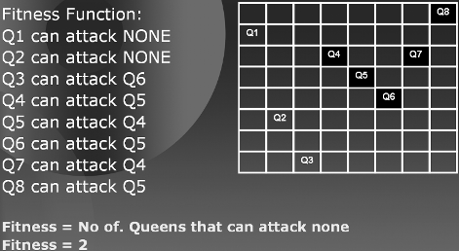
Eight Queens Problem

Slide 27
Eight Queens Problem
So once representation and fitness function is decided, the solution to the problem is simple.
Choose initial population
Evaluate the fitness of each individual
Choose the best individuals from the population for crossover

Slide 28
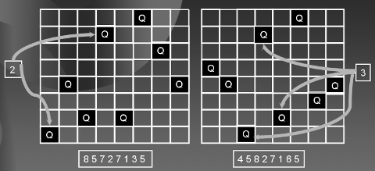
Let us quickly go though an example of how to solve this problem using GA. Suppose individuals (board positions) chosen for crossover are:

Slide 29
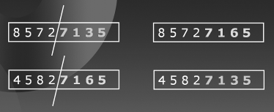
The following diagram shows how we apply crossover:
The individuals in the initial population are shown on the left and the children generated by swapping their tails are shown on the right.
Hence we now have a total of 4 candidate solutions. Depending on their fitness we will select the best two.

Slide 30
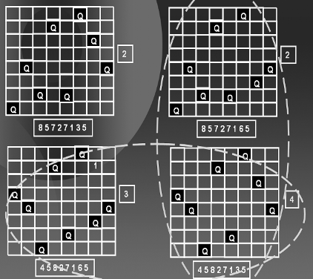
The diagram below shows where we select the best two on the bases of their fitness.
The vertical oval shows the children and the horizontal oval shows the selected individuals which are the fittest ones according to the fitness function.

Slide 31
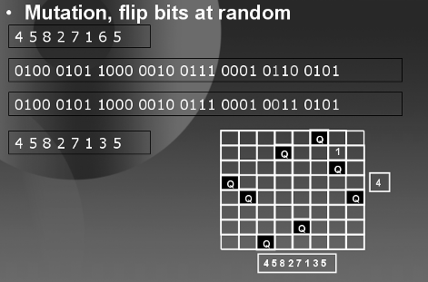
Similarly, the mutation step can be done as under.
That is, we represent the individual in binary and we flip at random a certain number of bits. You might as well decide to flip 1, 2, 3 or k number of bits, at random position. Hence GA is totally a random technique.

Slide 32
Eight Queens Problem
That is, we represent the individual in binary and we flip at random a certain number of bits. You might as well decide to flip 1, 2, 3 or k number of bits, at random position.
Hence GA is totally a random technique.
This process is repeated until an individual with required fitness level is found.
If no such individual is found, then the process is repeated till the overall fitness of the population or any of its individuals gets very close to the required fitness level.
An upper limit on the number of iterations is usually used to end the process in finite time.

Slide 33
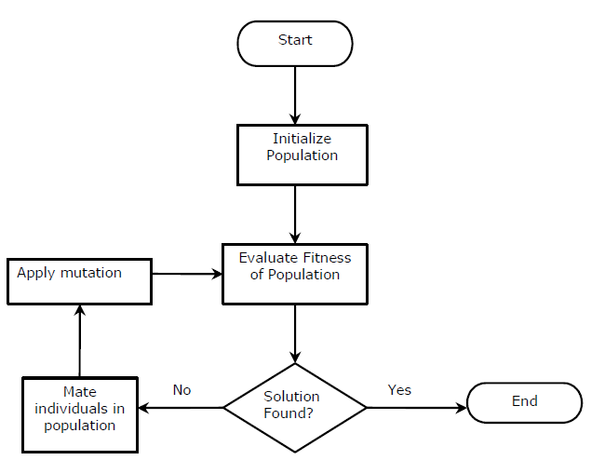
Flow Chart of Genetic Algorithm

Slide 34
Applications
You are encouraged to explore the internet and other books to find more applications of GA in various fields like:
Genetic Programming
Evolvable Systems
Composing Music
Gaming
Market Strategies
Robotics
Industrial Optimization
and many more.

Slide 35
Practice Question
Given pairs of (x, y) coordinates, find the best possible m, c parameters of the line y = mx + c that generates them. Use mutation only. Present the best possible solution given the data after at least three iterations of GA or exit if you find the solution earlier. (x, y) : {(1,12) (2, 13)}
Initial population [2 0][3 1]

